Slide 1

Sliding puzzle
Negin Naserzadeh
AP-1399-midterm-project

Slide 2
Where to start?
Our goal:
Given a board state, find a combination of moves that leads to the final state.
What are our moves?
Which tile does our moves depend on?
How can we implement it in c++?

Slide 3
What is BFS?
is an algorithm for traversing or searching tree or graph data structures. It starts at the tree root (or some arbitrary node of a graph, sometimes referred to as a search key), and explores all of the neighbour nodes at the present depth prior to moving on to the nodes at the next depth level.

Slide 4
What is DFS?
is an algorithm for traversing or searching tree or graph data structures. The algorithm starts at the root node
(selecting some arbitrary node as the root node in the case of a graph) and explores as far as possible along each branch before backtracking

Slide 5
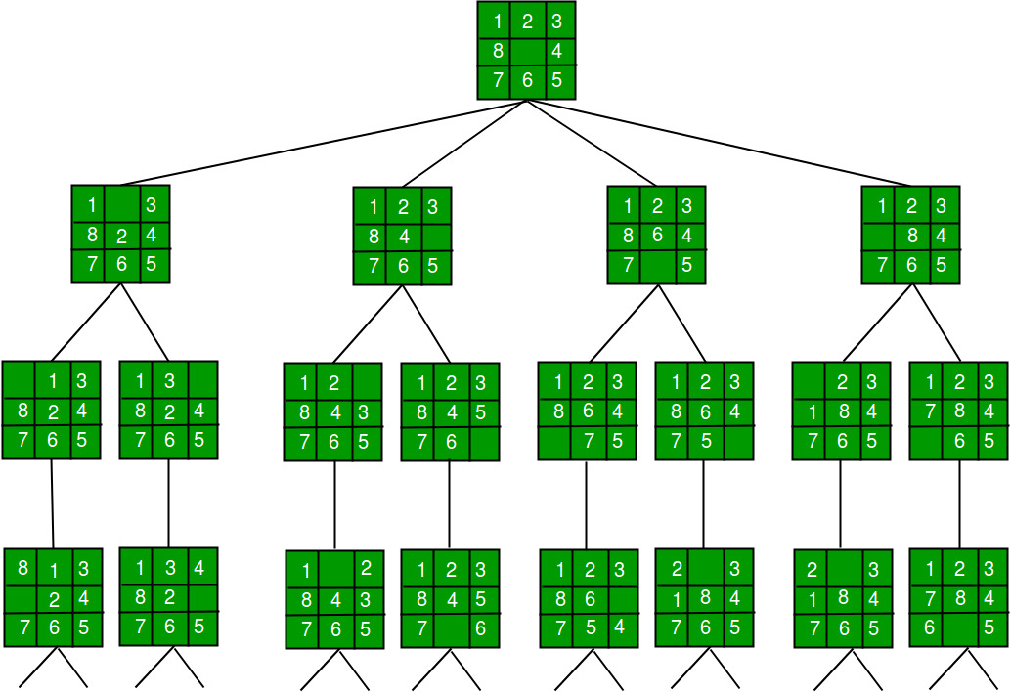
How should we implement these algorithms?
BFS :
Queue
FIFO
Initial board
Goal board
DFS:
Stack
LIFO
Initial board
Goal board
We should keep track of the visited nodes (I used set)

Slide 6
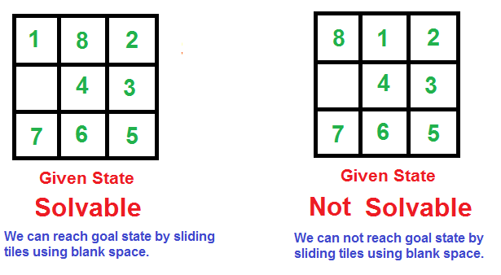
How to check if our puzzle is solvable?
it is not possible to solve an instance of 8 puzzle if number of inversions is odd in the input state

Slide 7
The end
References:
www.Geeksforgeeks.com
https://towardsdatascience.com/sliding-puzzle-solving-search-problem-with-iterative-deepening-a-d7e8c14eba04
https://en.wikipedia.org/wiki/Depth-first_search
https://en.wikipedia.org/wiki/Breadth-first_search
https://www.youtube.com/watch?v=mQZjx31C6aA
https://www.youtube.com/watch?v=41nDCiNcEbs&t=657s
https://www.youtube.com/watch?v=v78tWnjklio

